Slide 1
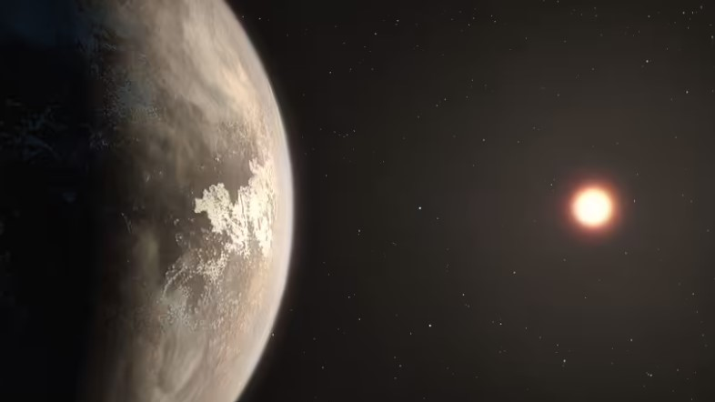
NASA’s Exo-planet DATABASE Analysis
By Christopher Figueroa

Slide 2
Introduction
Earth Similarity Index (ESI) – measures the similarity of exo-planets to Earth.
5,220 confirmed planets, 9,151 candidates
NASA Technical Reports Server (NTRS) stores the main exo-planet data
The Deep Space Network (DSN) stores the data collected from the space probes
Stored in a relational database model

Slide 3
The 4 ESI Variants
NASA’s Standard ESI
NASA’s Weighted ESI
Derived Custom ESI
Derived Revised ESI

Slide 4
Standard ESI
Measures 2 factors: stellar flux, and planet radius
The first of NASA’s ESI equations
Earth’s radius (Re) and stellar flux (Fe) serve as baseline

Slide 5
Weighted ESI
5 variables: stellar flux, radius, density, escape velocity, and temperature
Each variable has weights
More accurate than Standard ESI

Slide 6
Custom ESI
First of my own derived test ESI equations
9 variables in total, unweighted

Slide 7
Revised ESI
Weighted variant of the Custom ESI
Accounts factors such as temperature and star mass more heavily

Slide 8
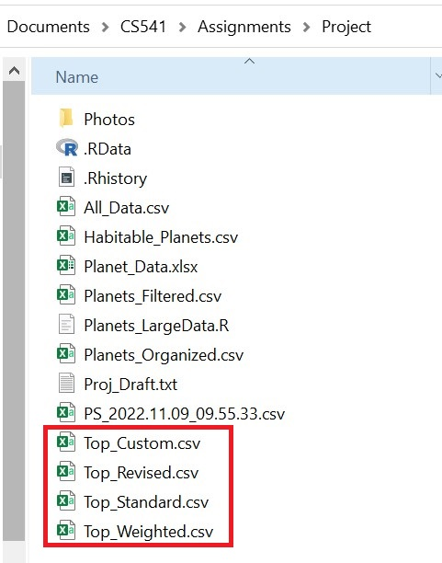
Coding setup
Downloaded NASA’s exoplanet catalog as a .csv file
Installed R language and R studio to process database
Filtered out unnecessary columns, 92 was the initial amount
Filtered out blank data to make ESI calculations possible

Slide 9
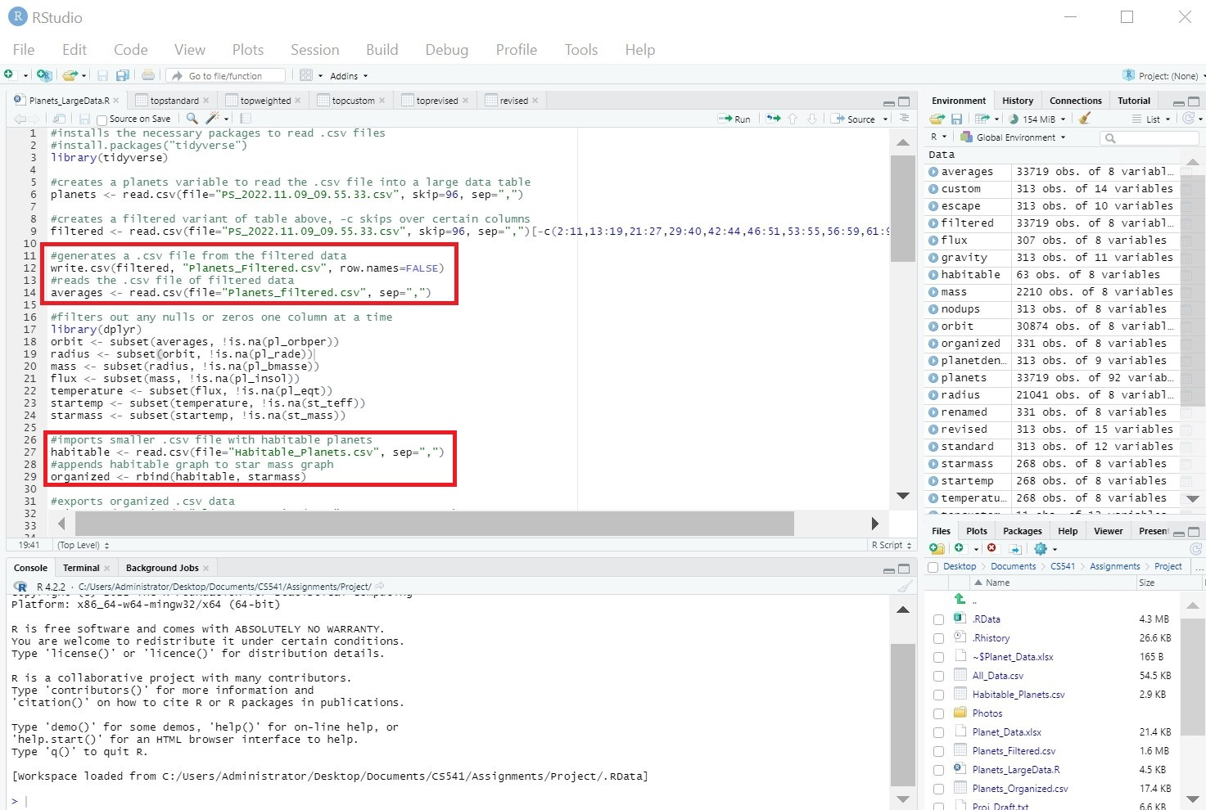

Slide 10
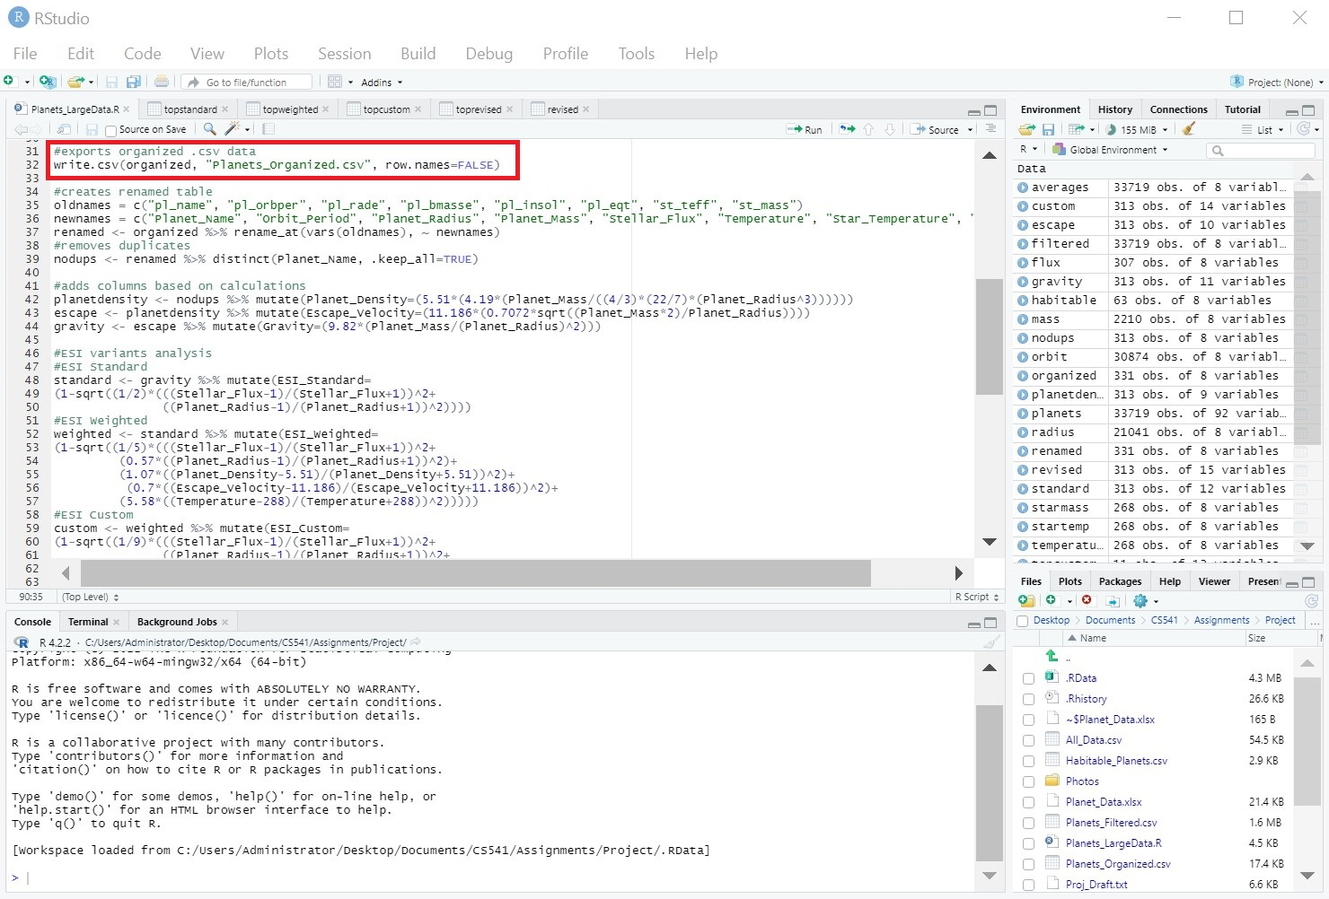

Slide 11
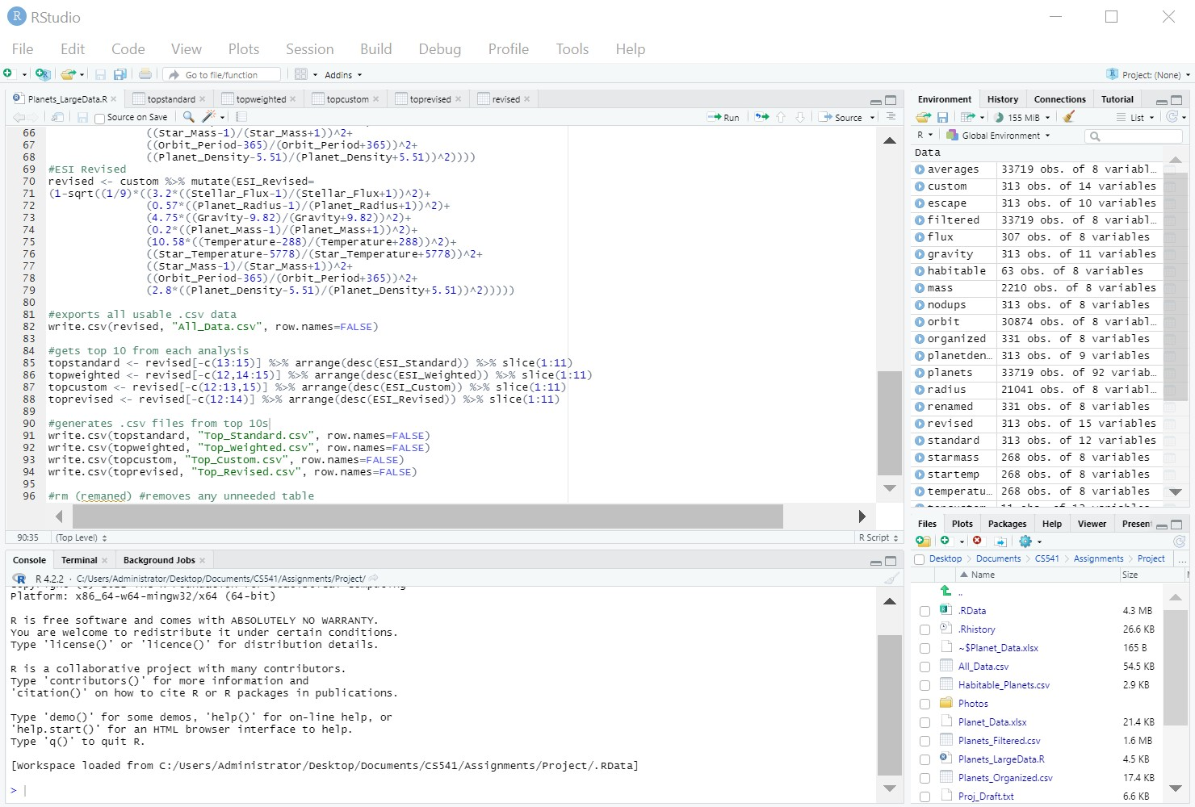

Slide 12
Export into gaben
ESI equations used to create 4 sub tables from the main filtered table
The main table and the 4 ESI tables were exported as .csv files
The .csv files were transferred over to the ”CS541” folder in the Gaben server
Made backup of data in hard drive due to possible SQL data corruption

Slide 13
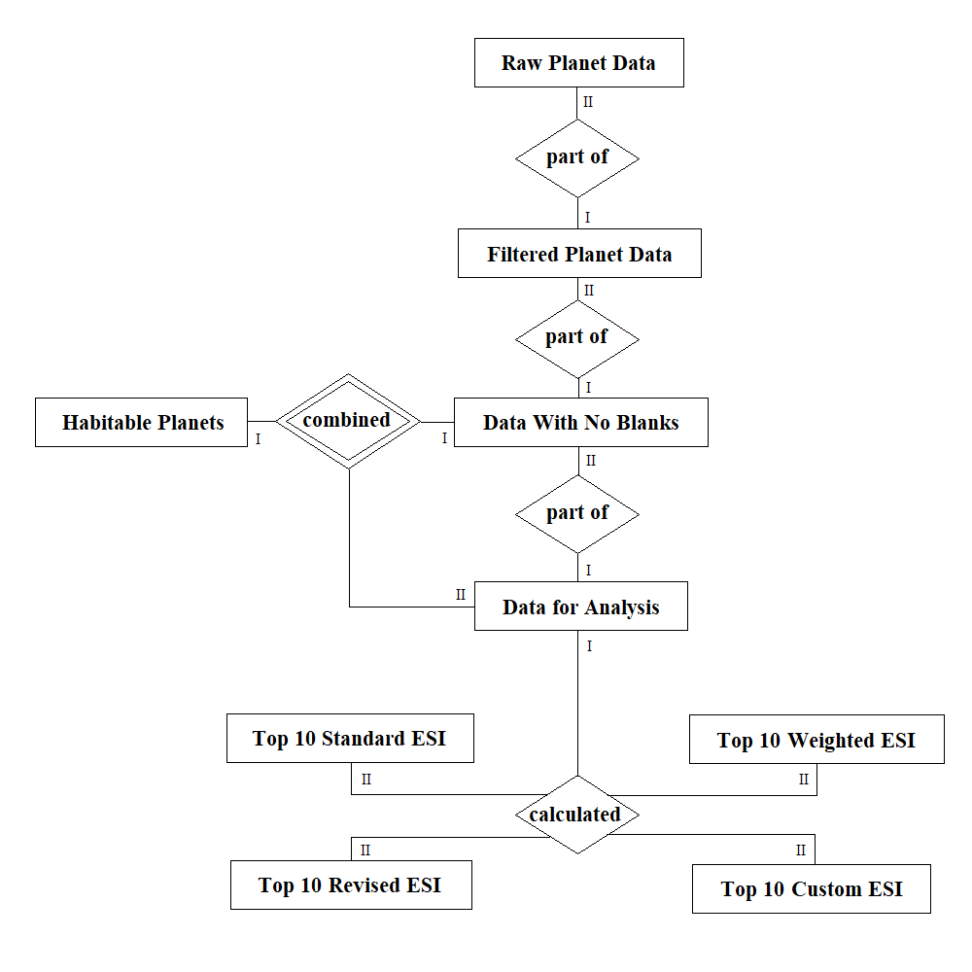
Relational diagram
The original raw .csv file is the source of all the data
“Habitable Planets” contains supplemental habitable exo-planet data
Column names differ between “Habitable Planets” and the filtered “Data with No Blanks”
Identifying relationship because of difference between those two tables

Slide 14
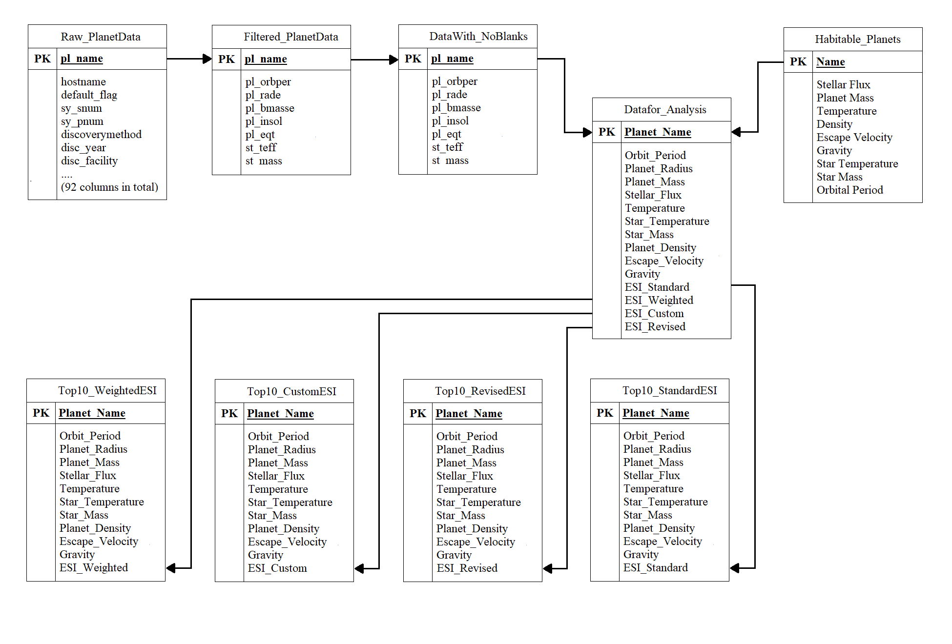
Table Layout

Slide 15
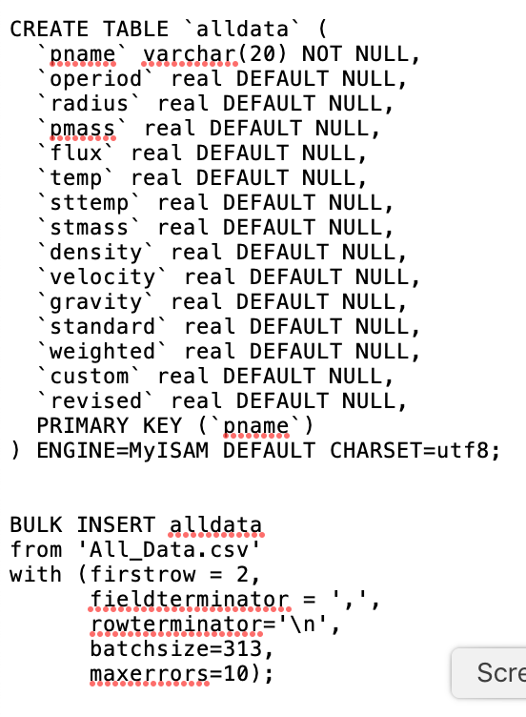
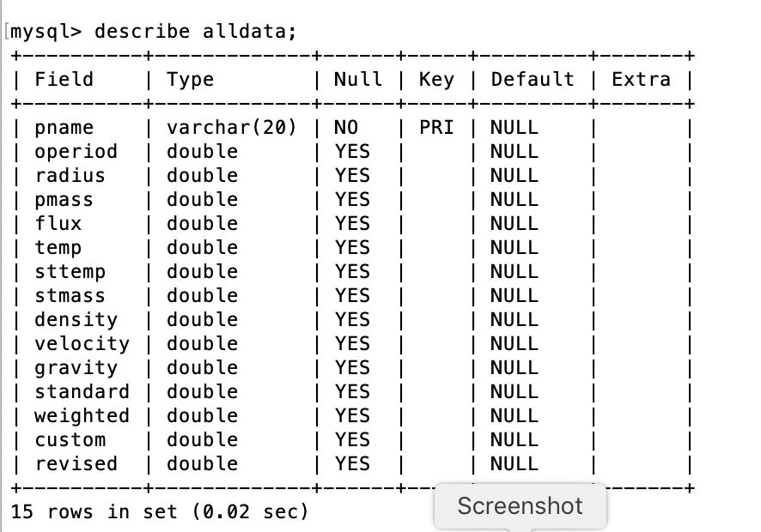
Insertion into SQL

Slide 16
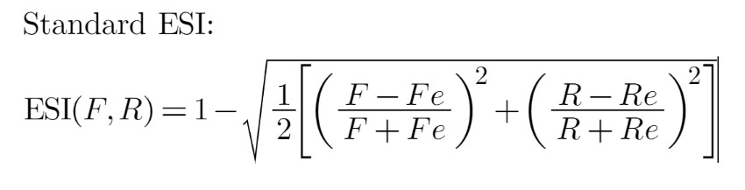
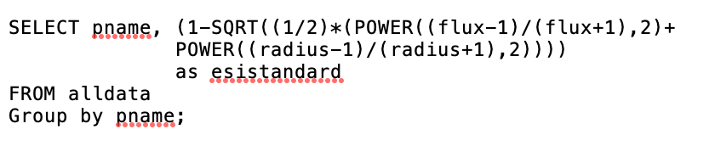
ESI SQL Queries
Added columns to the main Data for Analysis table
SQL query uses planet name for the “group by” function
Example below uses Standard ESI equation to create “esistandard” column

Slide 17
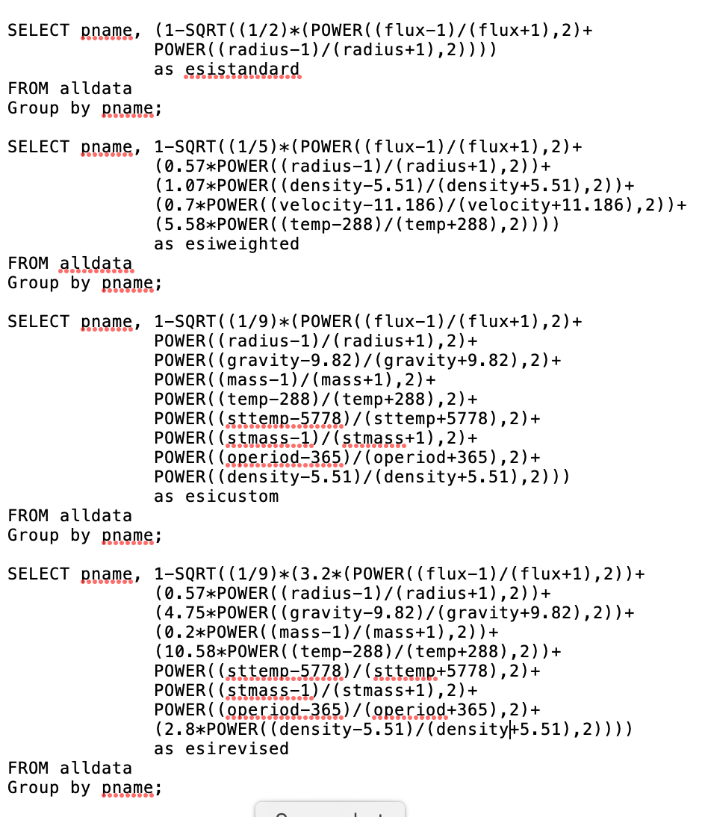
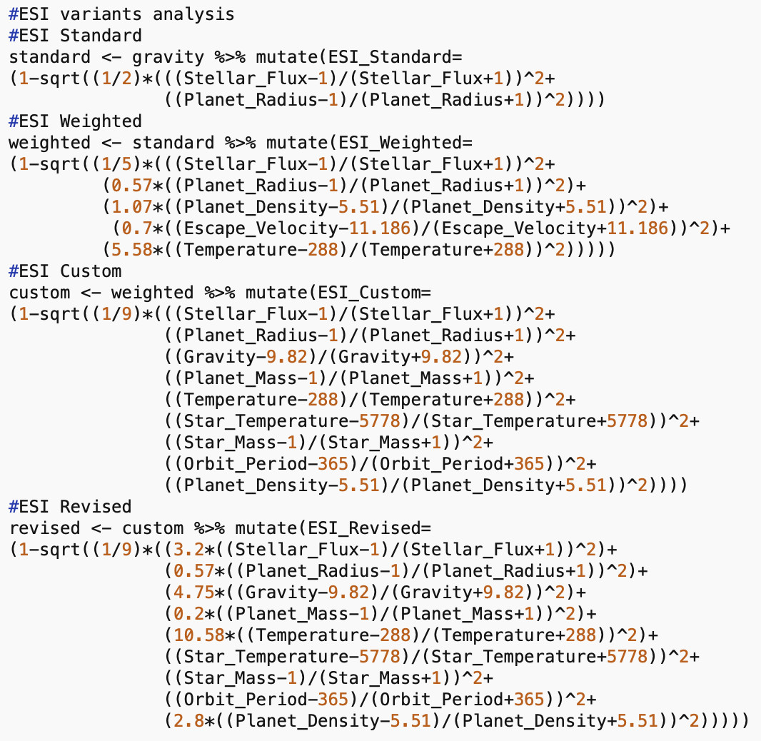
R and SQL comparison

Slide 18
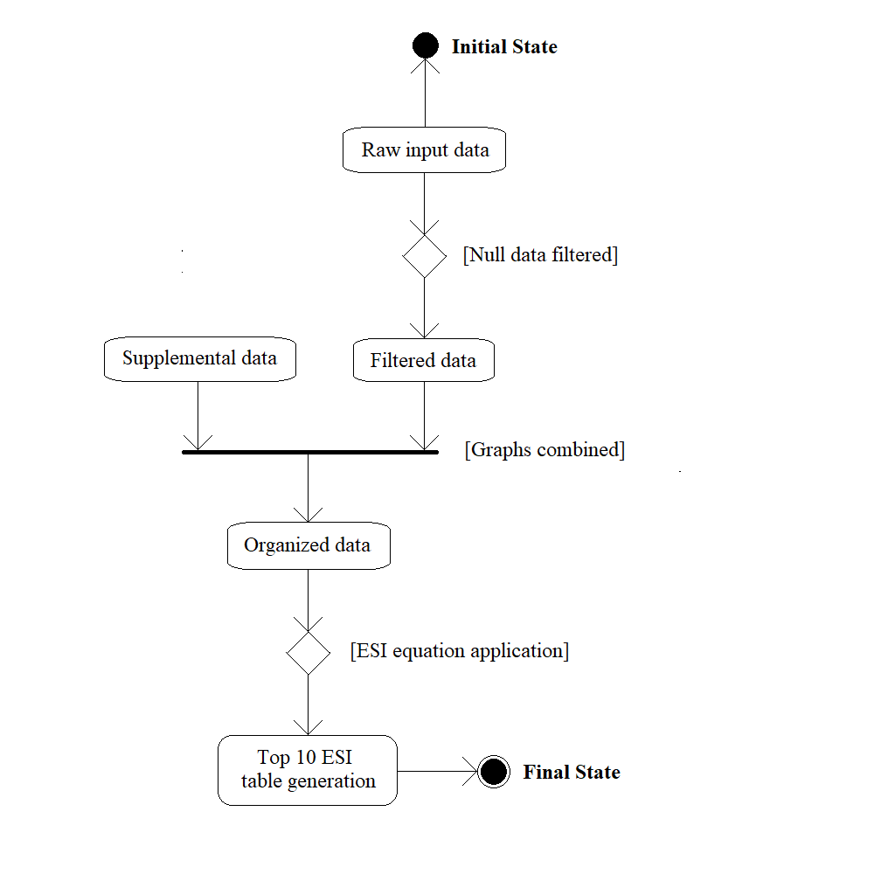
Software design diagram
Initial state is the downloaded NASA data
Final state is the generation of 4 top 10 ESI variant tables

Slide 19
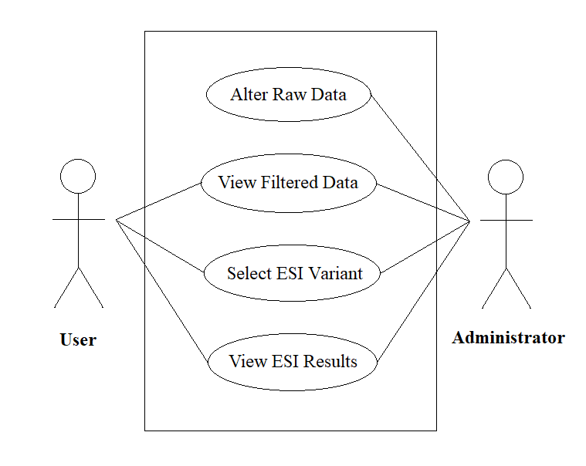
case diagram
Simple user interface
Options include selection and comparison of the ESI variants
Uses CSS to create menu
PHP to display tables

Slide 20
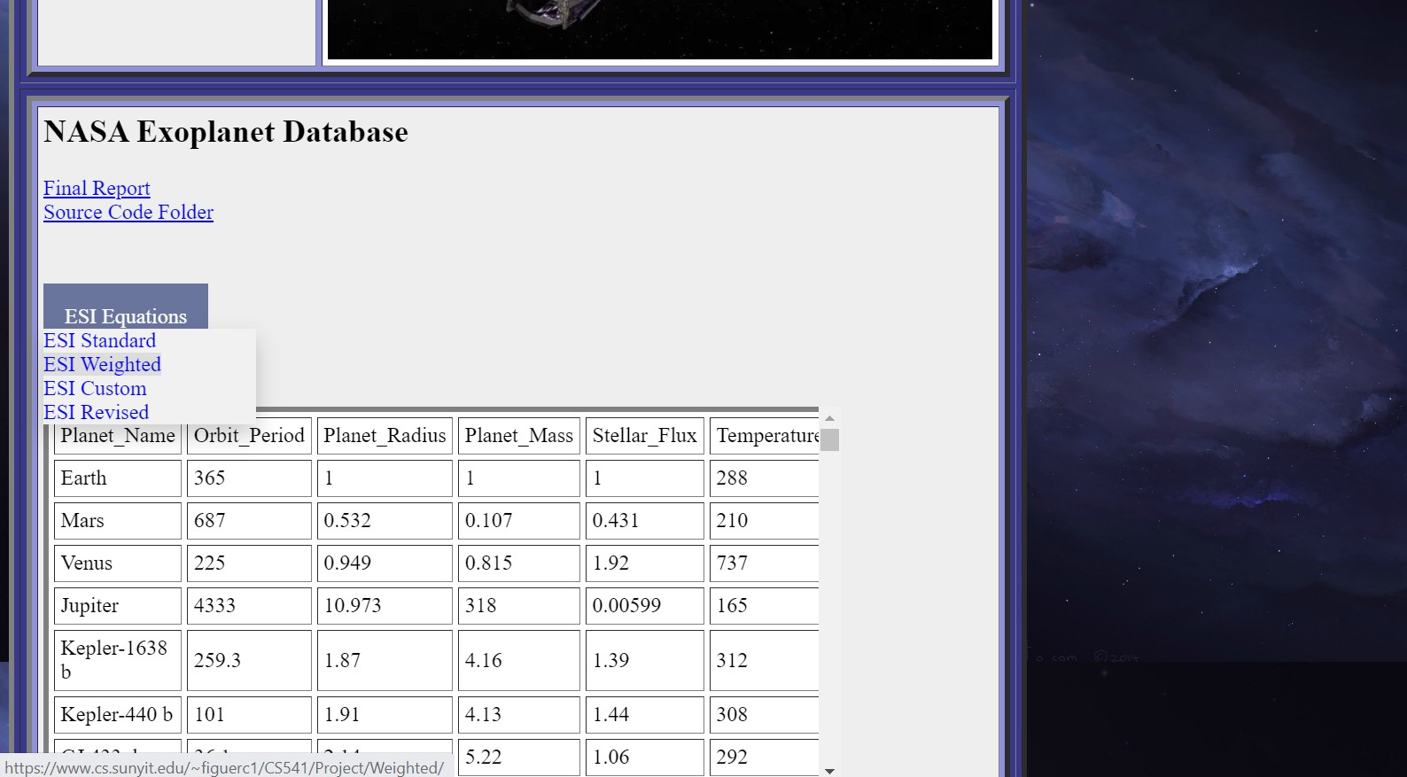
Website demo
Link: https://www.cs.sunyit.edu/~figuerc1/CS541/Project/

Slide 21
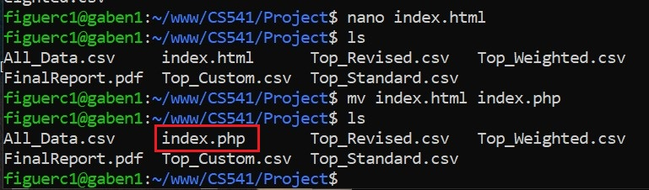
Challenges of coding
No direct link to NASA’s database server
Problem connecting R to Gaben server
Possible permissions restriction
Needed to copy .csv files into Gaben
Renamed index HTML file to PHP

Slide 22
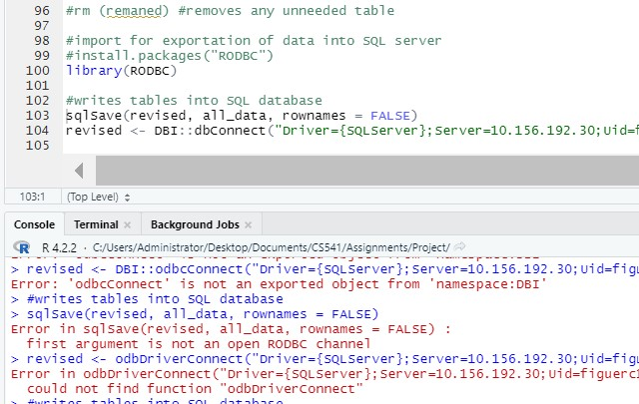

Slide 23
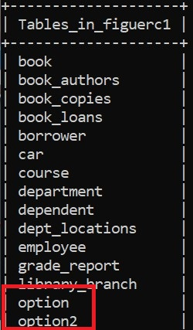
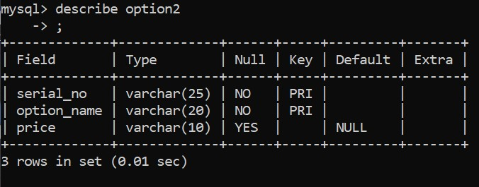
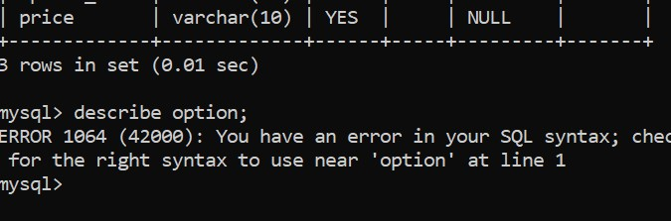
Database corruption

Slide 24
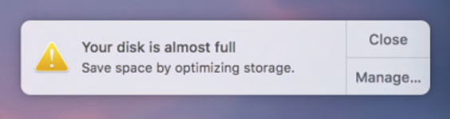
Why no more attempts?
Windows PC broke down
Stuck working with Mac with limited storage

Slide 25
Sources
[1] https://exoplanets.nasa.gov/discovery/exoplanet-catalog/
[2] https://phl.upr.edu/projects/habitable-exoplanets-catalog
[3] https://phl.upr.edu/projects/earth-similarity-index-esi
[4] https://interestingengineering.com/science/earth-similarity-index-where-could-we-livebesides-earth
[5] http://www.imatheq.com/imatheq/com/imatheq/math-equation-editor.html
[6] https://www.upi.com/Science_News/2017/02/08/NASA-Red-dwarf-habitable-zones-maynot-be-so-habitable/2881486579322/
[7] https://www.geeksforgeeks.org/how-to-display-data-from-csv-file-using-php/
[8] https://www.w3schools.com/howto/howto_css_dropdown.asp
[9] https://popsql.com/learn-sql/sql-server/how-to-import-a-csv-in-sql-server
[10] https://stackoverflow.com/questions/7367750/average-of-multiple-columns

